Slide 1


perugia 16 dicembre 2022
Giornata di studio sui Motori a Combustione Interna
Modellistica 1D di motori operanti con combustioni magre ed ultramagre – precamera e rcci
Fabio Bozza, Vincenzo De Bellis, Luigi Teodosio, Enrica Malfi
Gruppo di Ricerca EST - Dipartimento di Ingegneria Industriale
Università degli Studi di Napoli «Federico II»

Slide 2
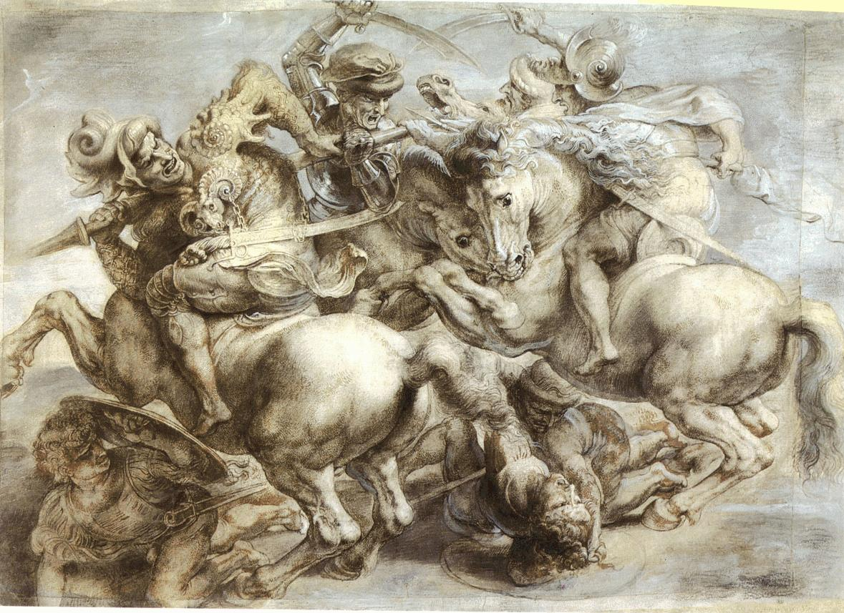


Background 1/4
Rubens reproduction of Leonardo’s Anghiari Battle
The «battle» between supporters of
fuel-fed vs electricity-fed HORSES
makes no-sense;
It is NOT a competition
between ICEs & BEVs;
What really matter is the common fight
against Pollution & Climate Changes;
Fuel-fed HORSES (ICEs)
vs
Electricity-fed HORSES (BEVs)
To win this challenge, electrical and thermal propulsion systems, are simultaneously needed, the latter characterized by increased efficiency, gained through development of unconventional fuels & combustion modes.

Slide 3
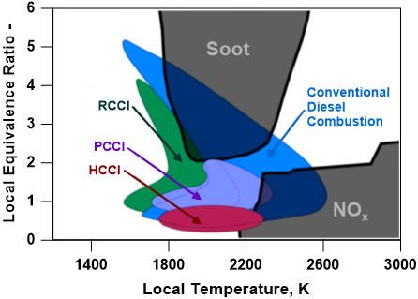
Background 2/4
Concerning the fuel-fed HORSE, the pathway to attain a substantial efficiency improvement is commonly considered a Low Temperature Combustion (LTC), achieved through Lean Operation;
Combustion by flame propagation is no more sustainable at lambda above 1.6-1.7. Many different “compression-ignition” combustion modes have been then developed (HCCI, PCCI, RCCI, SACI, …);
All of them are hard to control in terms of combustion phasing and pressure rise rate, especially at high load. Simulation models (mainly 3D-CFD) can help to fully exploit their pros, while minimizing the cons.

Slide 4
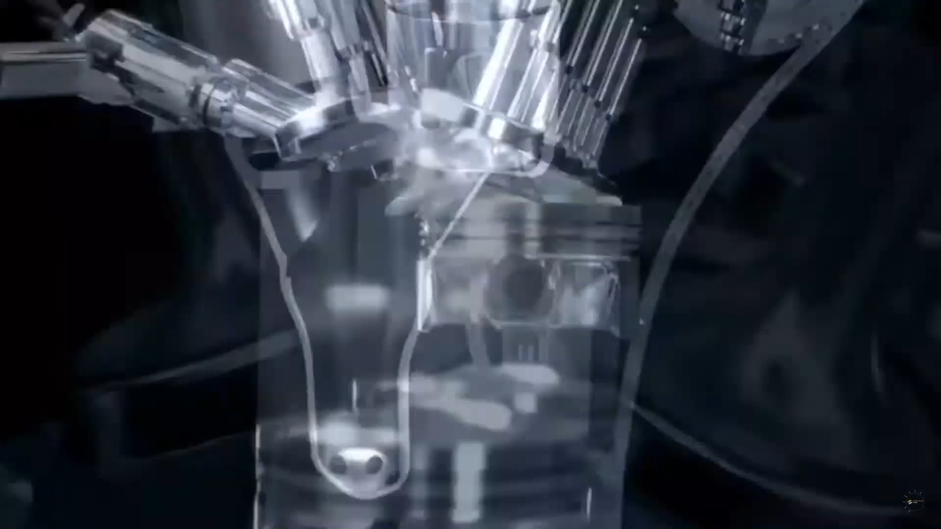
Background 3/4
A further promising combustion mode capable to realize stable lean-burn operation in Spark-Ignition engines is the Turbulent Jet Ignition (TJI);
High efficiency levels under ultra-lean operations (λ=2);
Low levels of engine-out NO and CO emissions.

Slide 5
Background 4/4
The innovative combustion modes require the development of advanced modelling approaches which differ from the ones adopted for standard combustion modes;
  Advanced «compression-ignition» combustion modes require:
            A multi-zone schematization of cylinder;
            Thermal stratification and fuel stratification within the cylinder;
            Kinetics of auto-ignition;
      Turbulent jet ignition requires:
            Modification of turbulence model to account for additional production induced by the jets;
            Burning rate enhancement induced by the turbulent jets.
A GENERAL COMBUSTION MODEL CAPABLE TO DESCRIBE STANDARD AND INNOVATIVE COMBUSTION MODES
External cylinder model object – UNINA user-coding

Slide 6
Presentation Guideline
Combustion modelling approaches:
    Standard mode (flame propagation);
    Innovative combustion modes (HCCI/RCCI-Dual Fuel, TJI);
Emission modelling;
Results discussion for innovative combustion modes (HCCI/RCCI-Dual Fuel, TJI);
Conclusions.

Slide 7
Presentation Guideline
Combustion modelling approaches:
    Standard mode (flame propagation);
    Innovative combustion modes (HCCI/RCCI-Dual Fuel, TJI);
Emission modelling;
Results discussion for innovative combustion modes (HCCI/RCCI-Dual Fuel, TJI);
Conclusions.

Slide 8
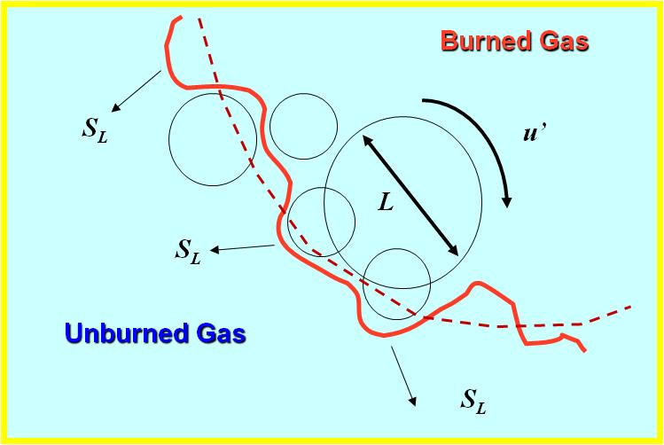
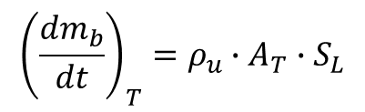
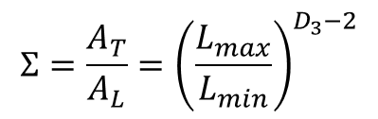
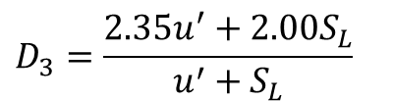
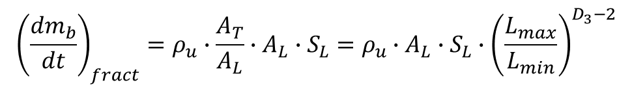


Standard combustion model
Based on experimental evidencies, the turbulent burning rate can be written as follows:
Spark ignition unit -
Conventional combustion chamber
$${\left(\frac{{dm}_{b}}{dt}\right)}_{T}=ρ_{u}∙A_{T}∙S_{L}$$
The flame area increase is modeled considering the fractal approach:
$${\left(\frac{{dm}_{b}}{dt}\right)}_{fract}=ρ_{u}∙\frac{A_{T}}{A_{L}}∙A_{L}∙S_{L}=ρ_{u}∙A_{L}∙S_{L}∙{\left(\frac{L_{max}}{L_{min}}\right)}^{D_{3}−2}$$
$$Σ=\frac{A_{T}}{A_{L}}={\left(\frac{L_{max}}{L_{min}}\right)}^{D_{3}−2}$$
$$D_{3}=\frac{2.35u^{′}+2.00S_{L}}{u^{′}+S_{L}}$$
$$A_{L}$$
Wrinkling factor
Fractal dimension
A turbulence sub-model is also required.
$$A_{T}$$

Slide 9
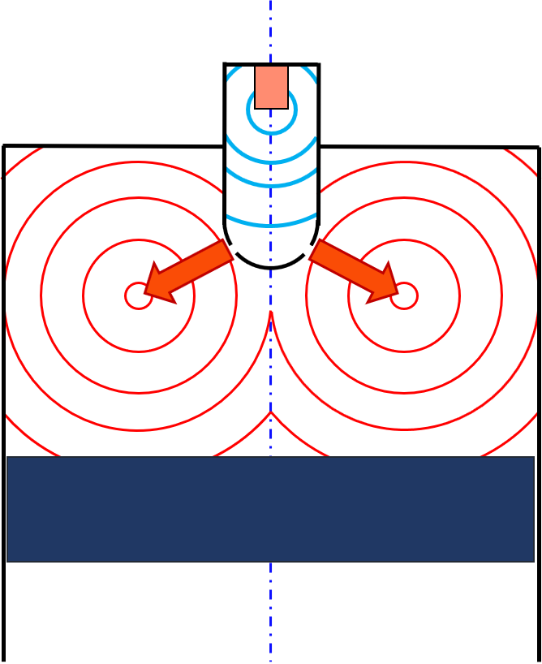
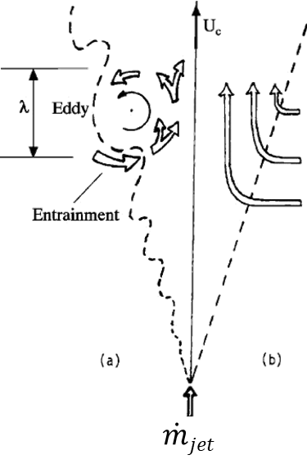
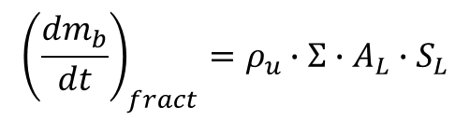
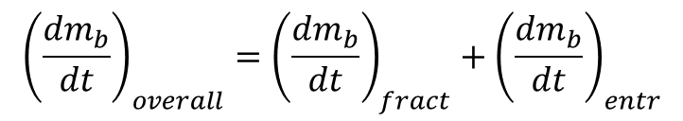
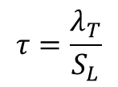
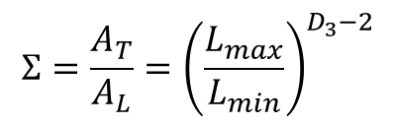
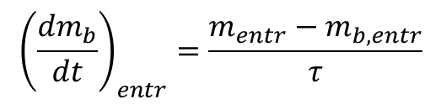
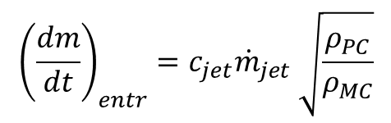
Pre-chamber combustion model
Fractal model represents the starting point to estimate the burning rate in both pre-chamber (PC) and main chamber (MC);
The burning rate formulation for main chamber has to be modified to take into account the contribution of incoming turbulent jets:
Simplified schematization of flame development in PC and MC
$${\left(\frac{{dm}_{b}}{dt}\right)}_{overall}={\left(\frac{{dm}_{b}}{dt}\right)}_{fract}+{\left(\frac{{dm}_{b}}{dt}\right)}_{entr}$$
$${\left(\frac{{dm}_{b}}{dt}\right)}_{fract}=ρ_{u}∙Σ∙A_{L}∙S_{L}$$
$$Σ=\frac{A_{T}}{A_{L}}={\left(\frac{L_{max}}{L_{min}}\right)}^{D_{3}−2}$$
$${\left(\frac{{dm}_{b}}{dt}\right)}_{entr}=\frac{m_{entr}−m_{b,entr}}{τ}$$
$${\left(\frac{dm}{dt}\right)}_{entr}=c_{jet}{\dot{m}}_{jet} \sqrt{\frac{ρ_{PC}}{ρ_{MC}}}$$
$$τ=\frac{λ_{T}}{S_{L}}$$

Slide 10
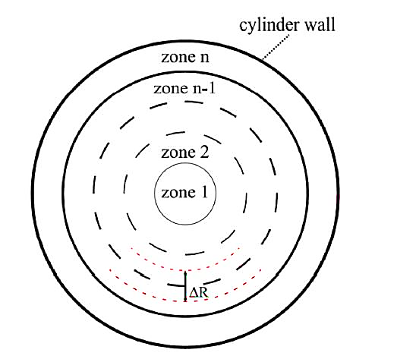
HCCI-RCCI/Dual Fuel models: multi-zone approach
    The in-cylinder volume of the engine is divided in a number of zones; the zones are ring-shaped and axial-symmetric;
    For HCCI engine, multi-zone schematization allows to take into account the thermal stratification among the zones;
    For RCCI/Dual Fuel engine, multi-zone schematization considers temperature and injected fuel stratifications within the cylinder;
    Zone-by-zone composition change is mainly due to the auto-ignition occurrence. Chemical kinetics is required to compute it in each zone through a “tabulated” procedure (TKI methodology).

Slide 11


TKI approach
Detailed AI chemistry is solved off-line (by Cantera) in constant volume (CV) reactor;
Starting from specified different initial conditions, the evolutions of the AI chemistry for a given fuel are synthesized in tables through a progress variable and its derivative;
The TKI methodology can perfectly reproduce pressure, temperature and Heat Release (HR) of the standard Cantera solution (KIN) for different fuels and initial conditions.
$$c=\frac{h_{f}\left(t\right)−h_{f}\left(0\right)}{h_{f}\left(end\right)−h_{f}\left(0\right)}$$
$${\overset{.}{c}}_{n}=\frac{c_{n+1}−c_{n}}{t_{n+1}−t_{n}}$$

Slide 12
HCCI model: thermal stratification
    1st Step: The Overall heat transferred to the wall is computed by a Hohenberg-like correlation, which makes use of a wall temperature solver to estimate Liner, Piston, and Head temperatures;
    2nd Step: The total heat transferred is allocated among the zones identifying a specific distribution for a given engine. It can be quite easily derived from 3D-CFD, and reveals to be rather independent on the operating conditions.
HT Fraction per unit mass
HT Fraction per zone (NZ=40)
B
B
A
A
C
C
Thermal Stratification (Case B)

Slide 13
RCCI/Dual Fuel model: fuel distribution
    For RCCI Engines, composition stratification of the most reactive fuel (Diesel) is imposed as a standardized lognormal distribution (as a substitute of the spray model);
    Standard deviation (σ) and peak location of the Diesel distribution are considered as tuning parameters.
lognormal distributions by varying σ
lognormal distribution by varying peak location

Slide 14
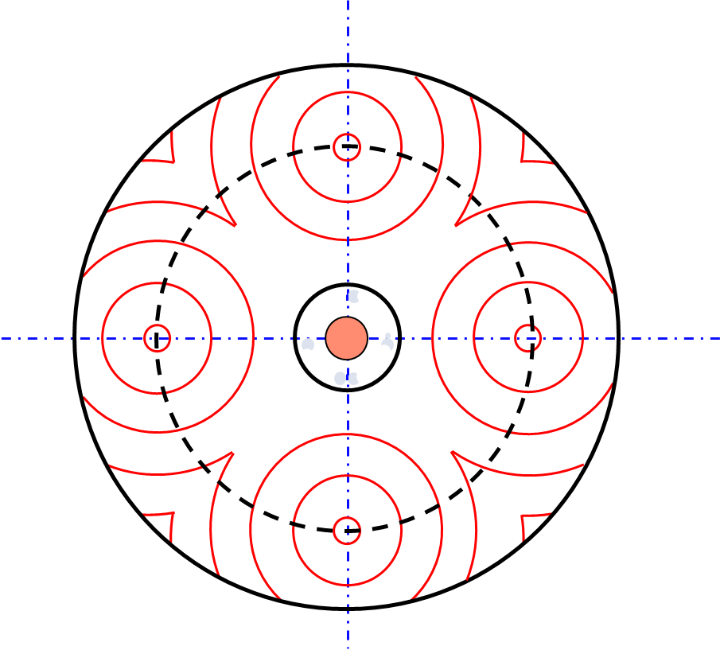
RCCI/Dual Fuel model: flame front evolution
    A number of spherical flame fronts are assumed to start from the zone where auto-ignition occurs first;
    The number of flame fronts is assumed equal to the number of injector holes and the propagation of flame fronts is modelled by the fractal approach;
    The calculation of the overall laminar area takes into account the interaction of the spheres and the contact with cylinder walls.
    Auto-ignition

Slide 15
Emission Modelling
NO is computed with a multi-zone approach for burned region. Zeldovich kinetic scheme is solved in each burned zone;
CO is computed employing a two-step reaction scheme (J. Heywood);
Unburned hydrocarbons (uHC) are computed with crevice mechanism, followed by in-cylinder post-oxidation of released HC flow;
A flame wall quenching sub-model allows to evaluate the quenching contribution to the overall unburned HC production (relevant for ultra-lean operation).

Slide 16
Presentation Guideline
Combustion modelling approaches:
    Standard mode (flame propagation);
    Innovative combustion modes (HCCI/RCCI-Dual Fuel, TJI);
Emission modelling;
Results discussion for innovative combustion modes (HCCI/RCCI-Dual Fuel, TJI);
Conclusions.

Slide 17
HCCI model: Results
HYDROGEN ENGINE
NO
T= 373 K
T= 383 K
T= 393 K
METHANE ENGINE
HC

Slide 18
RCCI/Dual Fuel model: Results
LOAD SWEEP
The RCCI/Dual Fuel model has been validated for a single-cylinder research engine designed for marine sector;
Engine is fueled with natural gas through the intake port and with light fuel oil by a direct high-pressure injector.
LOAD = 50%
LOAD = 50%

Slide 19
Prechamber model: In-cylinder pressure cycles

Slide 20
Prechamber model: Combustion and Performance
3000@13
3000@13
3000@13

Slide 21
Prechamber model: Emissions
NO
CO
HC
3000@13
3000@13
3000@13
The model correctly captures the engine-out emission trends (NO, CO and unburned HC) at incresing the air/gasoline mixture dilution in the main chamber;
Total HC emission derives from the crevice and quenching contributions.

Slide 22
Conclusions
A general numerical procedure to reproduce different combustion modes (Standard SI combustion, HCCI/RCCI-Dual Fuel, TJI) has been presented;
Discussed numerical results demonstrated the capability of the adopted modelling approaches to forecast the experimental-derived combustion evolution and emissions trends for the advanced combustion modes (HCCI/RCCI-Dual Fuel, TJI);
The general combustion model proved to be a reliable tool to be applied for the development of new engine architectures operating under the discussed advanced combustion modes.

Slide 23


Any questions?

